Slide 1
RESUME CLASSIFICATION
GROUP-4
TEAM MEMBERS:
Mr Harsha S
Mr Prajwal S Gondi
MS Thirumudi Nachiyar M K
MS Nirmala Machado
Mr Nachin H C
MS Pooja Rai

Slide 2
BUSINESS PROBLEM
To reduce manual effort in HRM by developing a highly accurate and automated document classification solution with minimal human intervention.

Slide 3
OBJECTIVE
The aim of this project is to develop a document classification solution that automates HRM processes, improves accuracy, and reduces the need for human intervention.

Slide 4
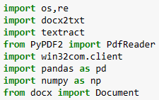
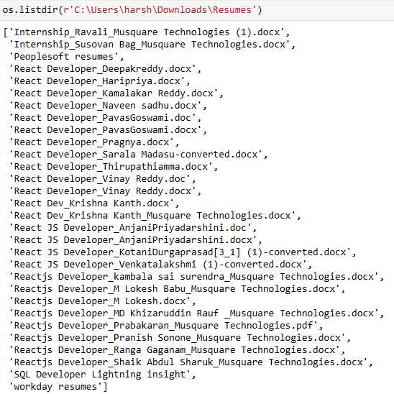
DATA EXTRACTION
Importing necessary library required.
Listing all files in file path.

Slide 5
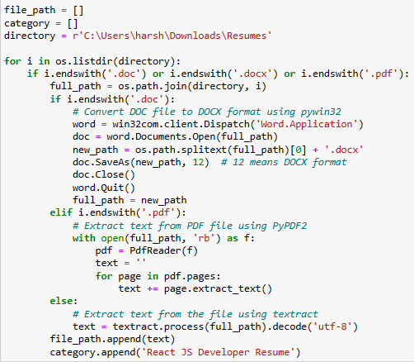
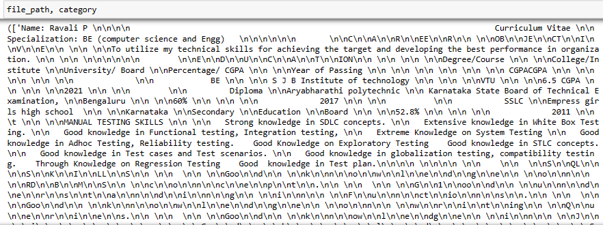
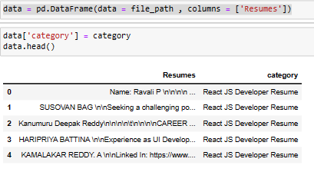
DATA EXTRACTION
Extracting data from file path for React JS Developer Resume.
Printing file path and their category.
Creating DataFrame for each category.

Slide 6
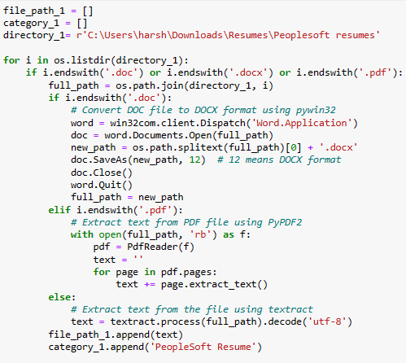
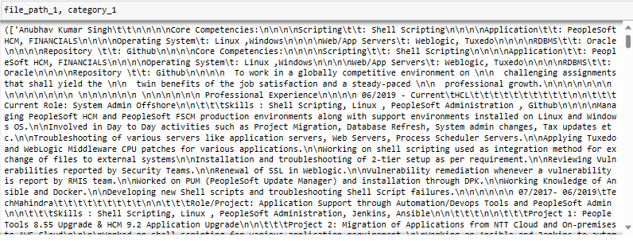
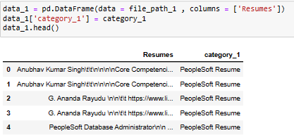
DATA EXTRACTION
Extracting data from file path for PeopleSoft Resume.
Printing file path and their category.
Creating DataFrame for each category.

Slide 7
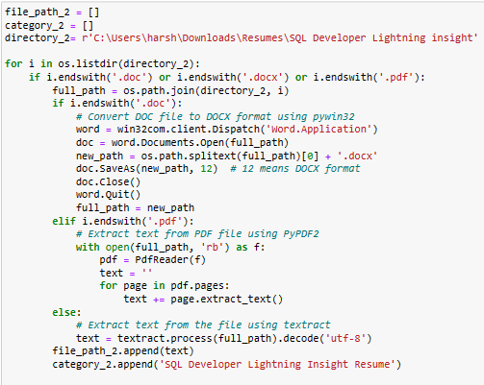
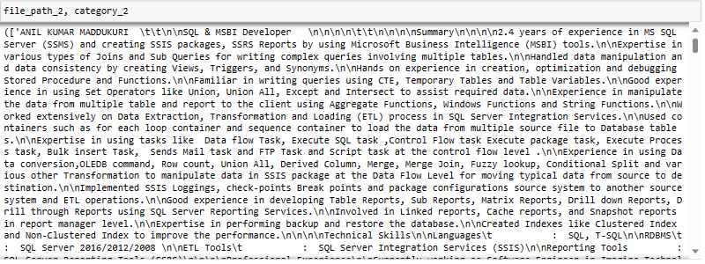
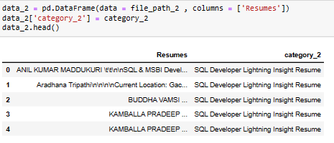
DATA EXTRACTION
Extracting data from file path for SQL Developer Lightning Insight Resume.
Printing file path and their category.
Creating DataFrame for each category.

Slide 8
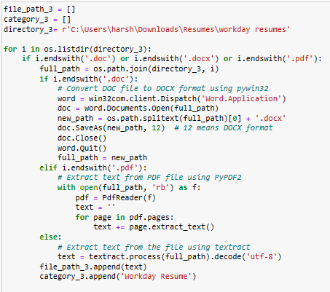
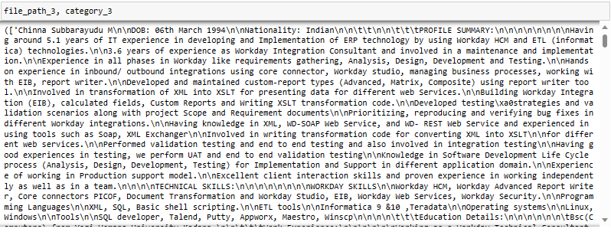
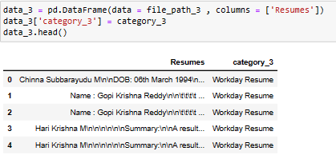
DATA EXTRACTION
Extracting data from file path for Workday Resume
Printing file path and their category.
Creating DataFrame for each category.

Slide 9
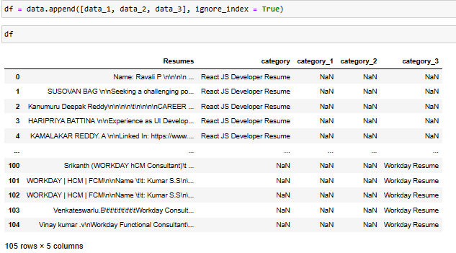
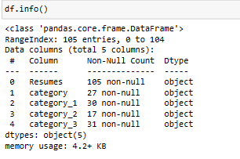
DATA EXTRACTION
Appending data_1, data_2, data_3 in data and creating single DataFrame.
Checking info() of each data type.

Slide 10
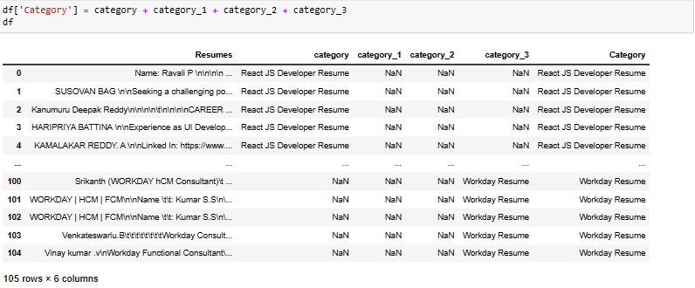
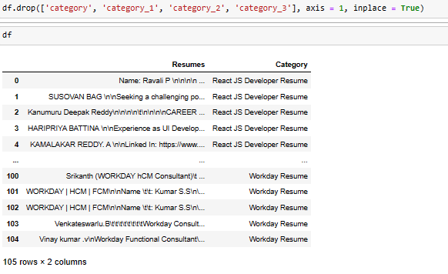
DATA EXTRACTION
Combining all category, category_1, category_2, category_3 and creating single feature.
Droping unnecessary feature.

Slide 11
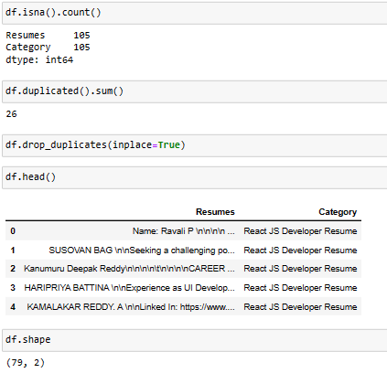
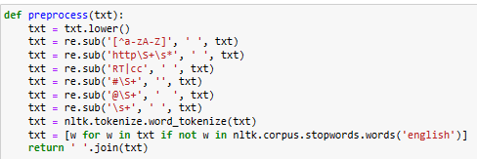
PREPROCESSING
Checking for null values.
Checking for duplicates and droping it.
Defining function for preprocessing.
Convert all characters in the string to lower case.
Remove non-alpanumeric characters such as punctuation and numbers.
Remove URLs.
Remove RT and CC.
Remove hashtags.
Remove mentions.
Remove extra whitespace.
Tokenize word.
Remove stop words.
Stemming

Slide 12
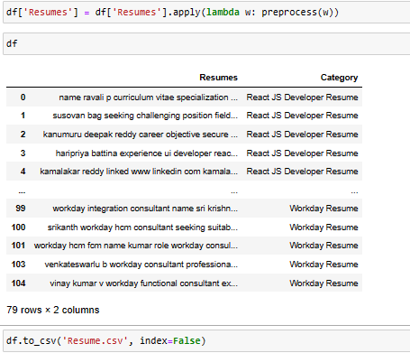
PREPROCESSING
Calling defined preprocess function and preprocessing Resumes feature.
Saving it to csv file.

Slide 13
EXPLORATORY DATA ANALYSIS(EDA)

Slide 14
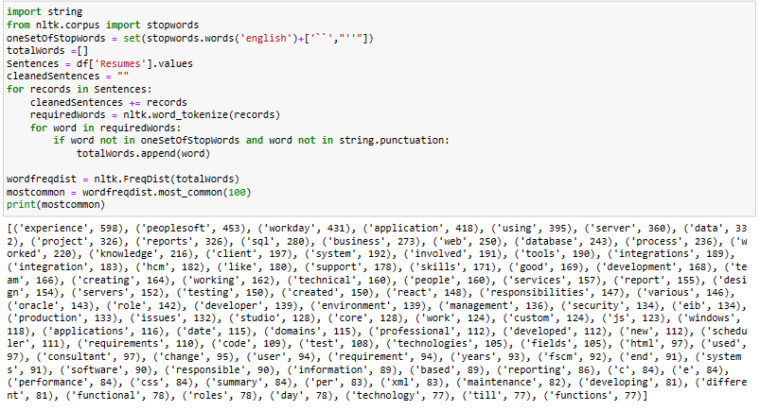
EXPLORATORY DATA ANALYSIS(EDA)
In this we are trying to record each word and printing it.

Slide 15
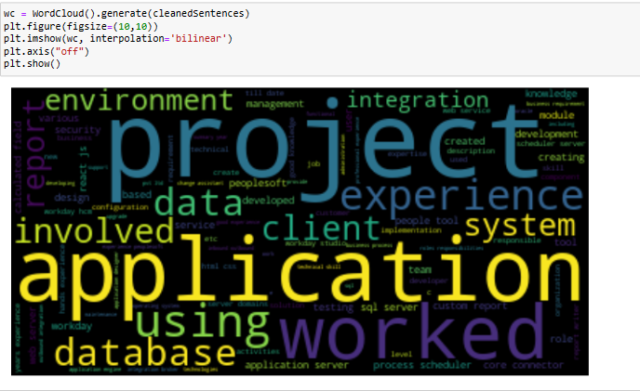
WORDCLOUD
Recorded words are Visualized using wordcloud.

Slide 16
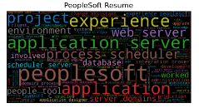
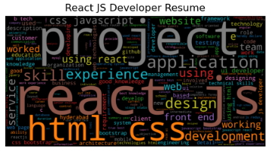
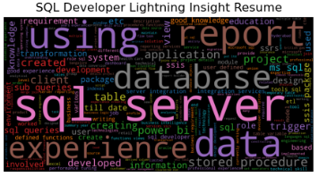
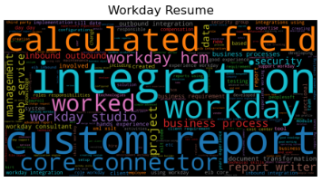
WORDCLOUD
Wordcloud plot for each Resume Category:
The most frequent used word is ‘peoplesoft’ in ‘PeopleSoft Resume’.
The most frequent used word is ‘react Js’ in ‘React JS Developer Resume’.
The most frequent used word is ‘sql server’ in ‘SQL Developer Lighting Insight Resume’.
The most frequent used word is ‘integration’ in ‘Workday Resume’.

Slide 17
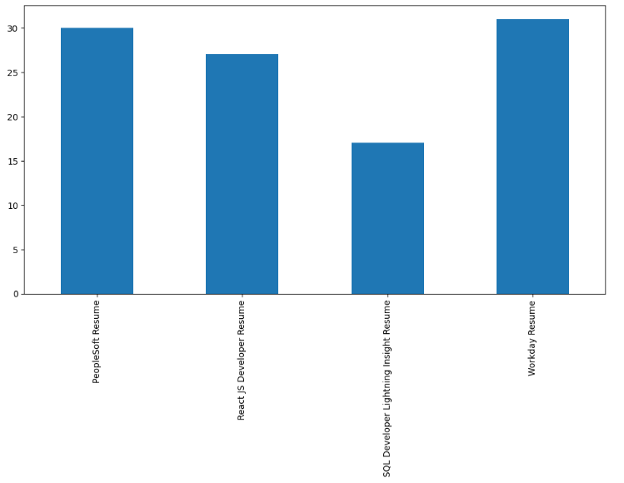
BAR PLOT
We observe that Work day resume occuring more number of times.
Peoplesoft resume is second highest.

Slide 18
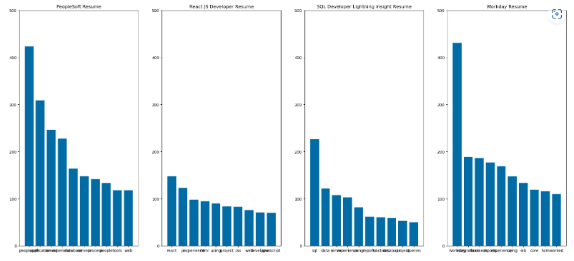
BAR PLOT
From the above graph we observe that below are highest occured word for each category.
Peoplesoft
react js
sql server
integration

Slide 19
THANK YOU

